Slide 1


Time for you to be a Decision Maker

Slide 2
The skills you will need to be a decision maker:
1. Analysing 2. Balanced thinking 3. Comparing 4. Deciding 5. Choosing 6. Judging

Slide 3
Synonym Work
WORD | SYNONYM
Analysing
Balanced
Comparing
Deciding
Choosing

Slide 4
Children’s Rights IN THE BONE SPARROW
From the UN Convention on the Rights of the Child
Notes:
https://www.humanrights.gov.au/convention-rights-child

Slide 5
‘Rights’ are what every child should have.
Australia agreed to the rights in the UN Convention on the Rights of the Child in 1990.
Notes:
https://www.humanrights.gov.au/convention-rights-child

Slide 6
There are 54 articles in the Convention on the Rights of the Child.
We will now look at some of these rights and you will decide if the characters in The Bone Sparrow have been treated according to these rights.
Notes:
https://www.humanrights.gov.au/convention-rights-child

Slide 7
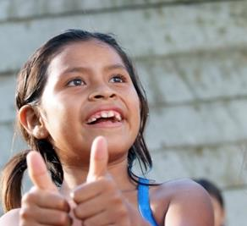
Article 1.
Everyone under 18 has these rights.
Notes:
Article 1
For the purposes of the present Convention, a child means every human being below the age of eighteen years unless under the law applicable to the child, majority is attained earlier.

Slide 8
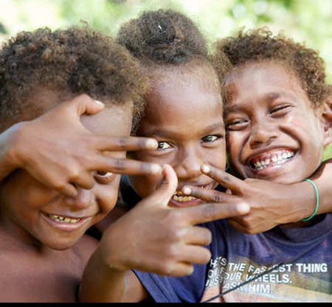
Article 2.
All rights are important and are the same for children everywhere!
Notes:
Article 2
1. States Parties shall respect and ensure the rights set forth in the present Convention to each child within their jurisdiction without discrimination of any kind, irrespective of the child's or his or her parent's or legal guardian's race, colour, sex, language, religion, political or other opinion, national, ethnic or social origin, property, disability, birth or other status.
2. States Parties shall take all appropriate measures to ensure that the child is protected against all forms of discrimination or punishment on the basis of the status, activities, expressed opinions, or beliefs of the child's parents, legal guardians, or family members

Slide 9
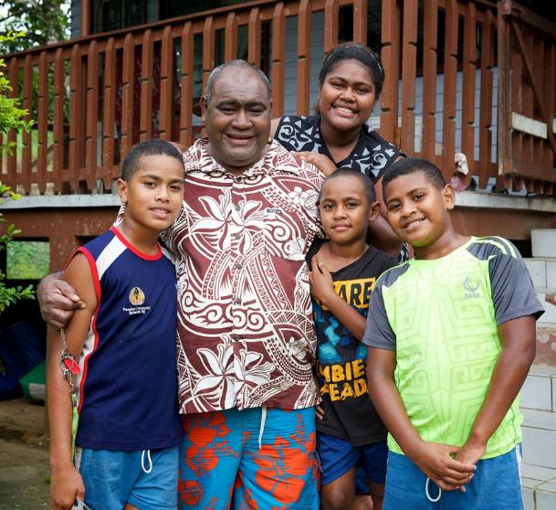
Article 3.
All adults should do what is best for you.
Credit: Richard Wainwright
Notes:
Article 3
1. In all actions concerning children, whether undertaken by public or private social welfare institutions, courts of law, administrative authorities or legislative bodies, the best interests of the child shall be a primary consideration.
2. States Parties undertake to ensure the child such protection and care as is necessary for his or her well-being, taking into account the rights and duties of his or her parents, legal guardians, or other individuals legally responsible for him or her, and, to this end, shall take all appropriate legislative and administrative measures.
3. States Parties shall ensure that the institutions, services and facilities responsible for the care or protection of children shall conform with the standards established by competent authorities, particularly in the areas of safety, health, in the number and suitability of their staff, as well as competent supervision.

Slide 10
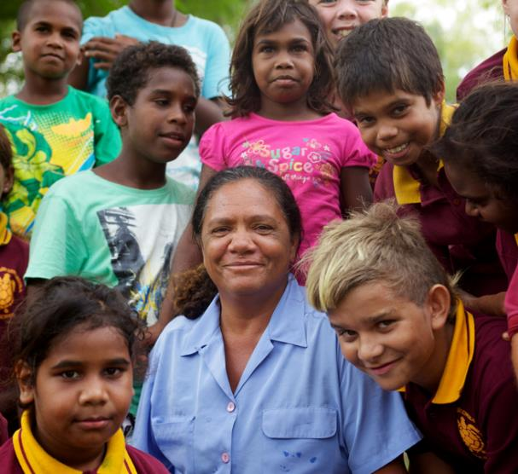
Article 4.
The government has a responsibility to make sure your rights are protected. They must help your family to protect your rights and create an environment where you can grow and reach your potential.
Credit: Caritas Australia
Notes:
Article 4
States Parties shall undertake all appropriate legislative, administrative, and other measures for the implementation of the rights recognized in the present Convention. With regard to economic, social and cultural rights, States Parties shall undertake such measures to the maximum extent of their available resources and, where needed, within the framework of international co-operation.

Slide 11
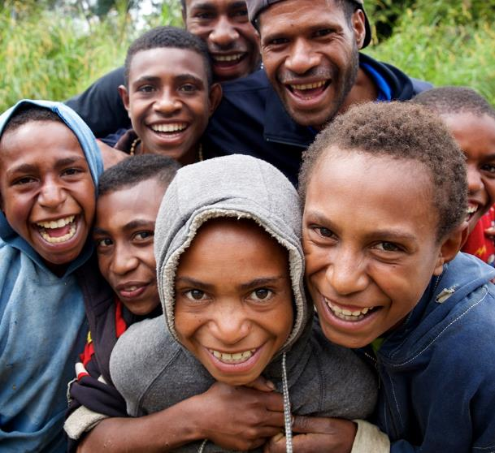
Article 5.
Your family has the responsibility to help you learn to exercise your rights, and to ensure that your rights are protected.
Credit: Richard Wainwright
Notes:
The child shall enjoy the benefits of social security. He shall be entitled to grow and develop in health; to this end, special care and protection shall be provided both to him and to his mother, including adequate pre-natal and post-natal care. The child shall have the right to adequate nutrition, housing, recreation and medical services.

Slide 12
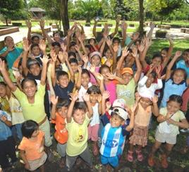
Article 6.
Children have the right to live. Governments should ensure that children survive and develop healthily.
Credit: Wayne Quilliam
Notes:
Article 6
1. States Parties recognize that every child has the inherent right to life.
2. States Parties shall ensure to the maximum extent possible the survival and development of the child.

Slide 13
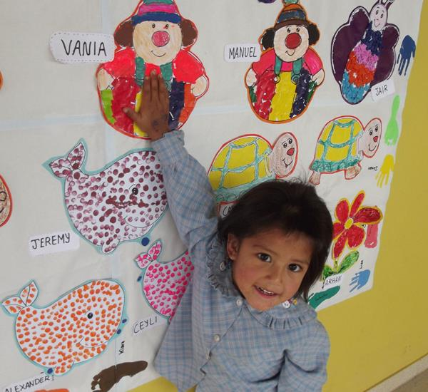
Article 7.
You have the right to a name and to a nationality (to belong to a country).
Credit: Caritas Australia
Notes:
Article 7
1. The child shall be registered immediately after birth and shall have the right from birth to a name, the right to acquire a nationality and. as far as possible, the right to know and be cared for by his or her parents.
2. States Parties shall ensure the implementation of these rights in accordance with their national law and their obligations under the relevant international instruments in this field, in particular where the child would otherwise be stateless.

Slide 14
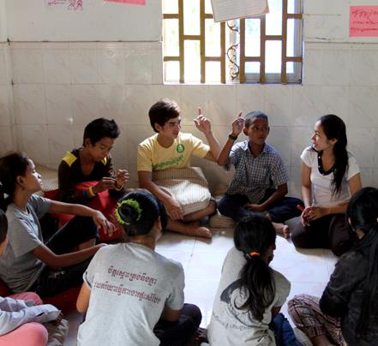
Article 12.
You have the right to give your opinion, and for adults to listen and take it seriously.
Credit: Philong Sovan
Notes:
Article 12
1. States Parties shall assure to the child who is capable of forming his or her own views the right to express those views freely in all matters affecting the child, the views of the child being given due weight in accordance with the age and maturity of the child.
2. For this purpose, the child shall in particular be provided the opportunity to be heard in any judicial and administrative proceedings affecting the child, either directly, or through a representative or an appropriate body, in a manner consistent with the procedural rules of national law.

Slide 15
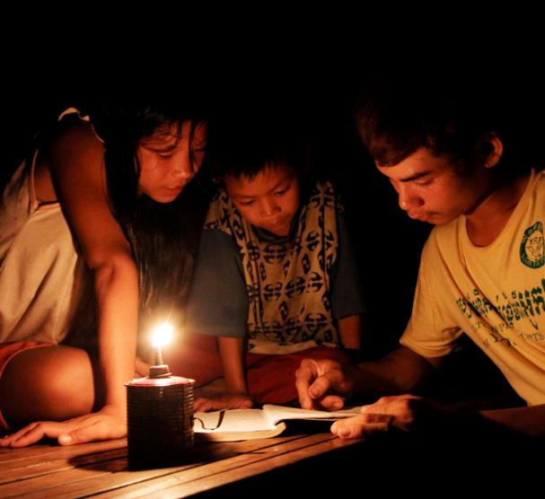
Article 13.
You have the right to find out things and share what you think with others.
Credit: Philong Sovan
Notes:
Article 13
1. The child shall have the right to freedom of expression; this right shall include freedom to seek, receive and impart information and ideas of all kinds, regardless of frontiers, either orally, in writing or in print, in the form of art, or through any other media of the child's choice.
2. The exercise of this right may be subject to certain restrictions, but these shall only be such as are provided by law and are necessary:
(a) For respect of the rights or reputations of others; or
(b) For the protection of national security or of public order (ordre public), or of public health or morals.

Slide 16
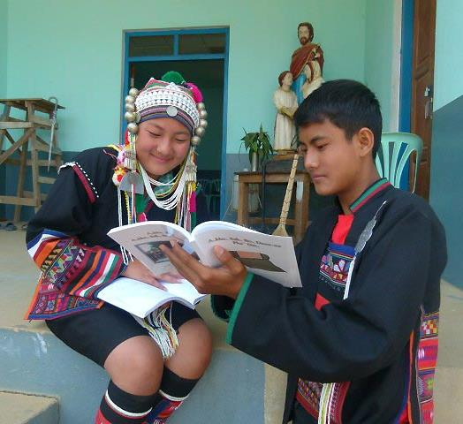
Article 14.
You have the right to choose your own religion and beliefs. Your parents should help you decide what is right and wrong, and what is best for you.
Credit: Fr Stephen Ano
Notes:
Article 14
1. States Parties shall respect the right of the child to freedom of thought, conscience and religion.
2. States Parties shall respect the rights and duties of the parents and, when applicable, legal guardians, to provide direction to the child in the exercise of his or her right in a manner consistent with the evolving capacities of the child.
3. Freedom to manifest one's religion or beliefs may be subject only to such limitations as are prescribed by law and are necessary to protect public safety, order, health or morals, or the fundamental rights and freedoms of others.

Slide 17
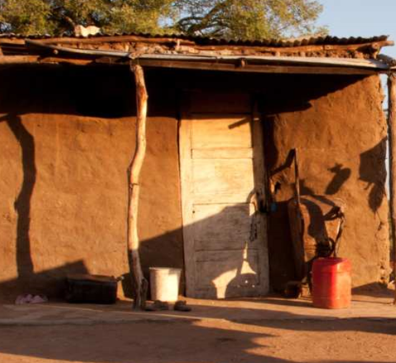
Article 16.
You have the right to privacy.
Credit: Erin Johnson
Notes:
Article 16
1. No child shall be subjected to arbitrary or unlawful interference with his or her privacy, family, or correspondence, nor to unlawful attacks on his or her honour and reputation.
2. The child has the right to the protection of the law against such interference or attacks.

Slide 18
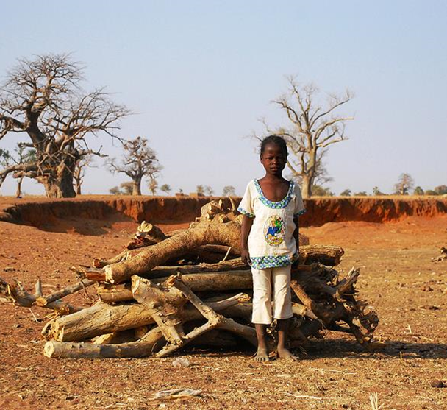
Article 19.
You have the right to be protected from being hurt and mistreated, physically or mentally.
Credit: Caritas Switzerland
Notes:
Article 19
1. States Parties shall take all appropriate legislative, administrative, social and educational measures to protect the child from all forms of physical or mental violence, injury or abuse, neglect or negligent treatment, maltreatment or exploitation, including sexual abuse, while in the care of parent(s), legal guardian(s) or any other person who has the care of the child.
2. Such protective measures should, as appropriate, include effective procedures for the establishment of social programmes to provide necessary support for the child and for those who have the care of the child, as well as for other forms of prevention and for identification, reporting, referral, investigation, treatment and follow-up of instances of child maltreatment described heretofore, and, as appropriate, for judicial involvement.

Slide 19
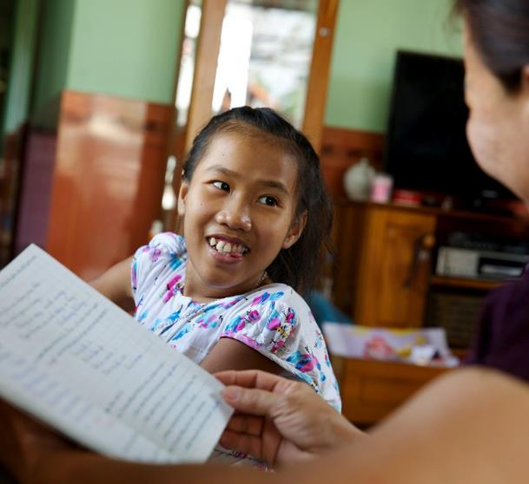
Article 23.
You have the right to special education and care if you have a disability, as well as all the rights in this Convention, so that you can live a full life.
Credit: Richard Wainwright
Notes:
Article 23
1. States Parties recognize that a mentally or physically disabled child should enjoy a full and decent life, in conditions which ensure dignity, promote self-reliance and facilitate the child's active participation in the community.
2. States Parties recognize the right of the disabled child to special care and shall encourage and ensure the extension, subject to available resources, to the eligible child and those responsible for his or her care, of assistance for which application is made and which is appropriate to the child's condition and to the circumstances of the parents or others caring for the child.
3. Recognizing the special needs of a disabled child, assistance extended in accordance with paragraph 2 of the present article shall be provided free of charge, whenever possible, taking into account the financial resources of the parents or others caring for the child, and shall be designed to ensure that the disabled child has effective access to and receives education, training, health care services, rehabilitation services, preparation for employment and recreation opportunities in a manner conducive to the child's achieving the fullest possible social integration and individual development, including his or her cultural and spiritual development
4. States Parties shall promote, in the spirit of international cooperation, the exchange of appropriate information in the field of preventive health care and of medical, psychological and functional treatment of disabled children, including dissemination of and access to information concerning methods of rehabilitation, education and vocational services, with the aim of enabling States Parties to improve their capabilities and skills and to widen their experience in these areas. In this regard, particular account shall be taken of the needs of developing countries.

Slide 20
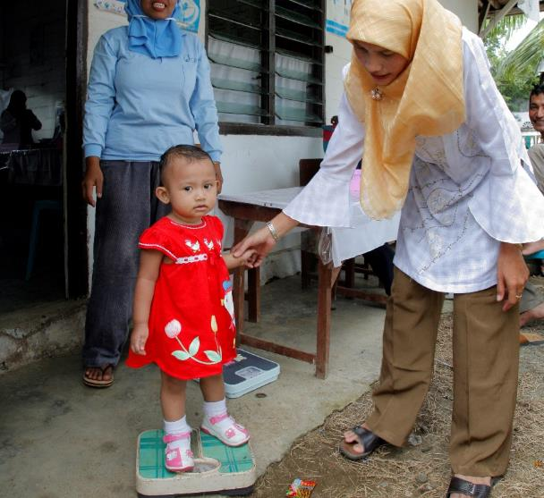
Article 24.
You have the right to the best health care possible, safe water to drink, nutritious food, a clean and safe environment, and information to help you stay well.
Credit: Sean Sprague
Notes:
Article 24
1. States Parties recognize the right of the child to the enjoyment of the highest attainable standard of health and to facilities for the treatment of illness and rehabilitation of health. States Parties shall strive to ensure that no child is deprived of his or her right of access to such health care services.
2. States Parties shall pursue full implementation of this right and, in particular, shall take appropriate measures:
(a) To diminish infant and child mortality;
(b) To ensure the provision of necessary medical assistance and health care to all children with emphasis on the development of primary health care;
(c) To combat disease and malnutrition, including within the framework of primary health care, through, inter alia, the application of readily available technology and through the provision of adequate nutritious foods and clean drinking-water, taking into consideration the dangers and risks of environmental pollution;
(d) To ensure appropriate pre-natal and post-natal health care for mothers;
(e) To ensure that all segments of society, in particular parents and children, are informed, have access to education and are supported in the use of basic knowledge of child health and nutrition, the advantages of breastfeeding, hygiene and environmental sanitation and the prevention of accidents;
(f) To develop preventive health care, guidance for parents and family planning education and services.
3. States Parties shall take all effective and appropriate measures with a view to abolishing traditional practices prejudicial to the health of children.
4. States Parties undertake to promote and encourage international co-operation with a view to achieving progressively the full realization of the right recognized in the present article. In this regard, particular account shall be taken of the needs of developing countries.

Slide 21
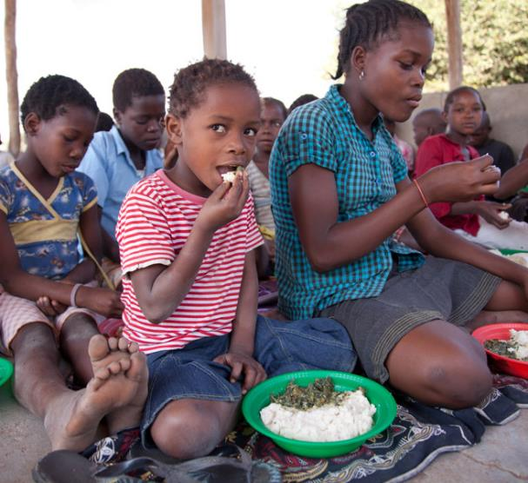
Article 27.
You have the right to have your basic needs met. You should not be disadvantaged so that you can't do many of the things other kids can do.
Credit: Erin Johnson
Notes:
Article 27
1. States Parties recognize the right of every child to a standard of living adequate for the child's physical, mental, spiritual, moral and social development.
2. The parent(s) or others responsible for the child have the primary responsibility to secure, within their abilities and financial capacities, the conditions of living necessary for the child's development.
3. States Parties, in accordance with national conditions and within their means, shall take appropriate measures to assist parents and others responsible for the child to implement this right and shall in case of need provide material assistance and support programmes, particularly with regard to nutrition, clothing and housing.
4. States Parties shall take all appropriate measures to secure the recovery of maintenance for the child from the parents or other persons having financial responsibility for the child, both within the State Party and from abroad. In particular, where the person having financial responsibility for the child lives in a State different from that of the child, States Parties shall promote the accession to international agreements or the conclusion of such agreements, as well as the making of other appropriate arrangements.

Slide 22
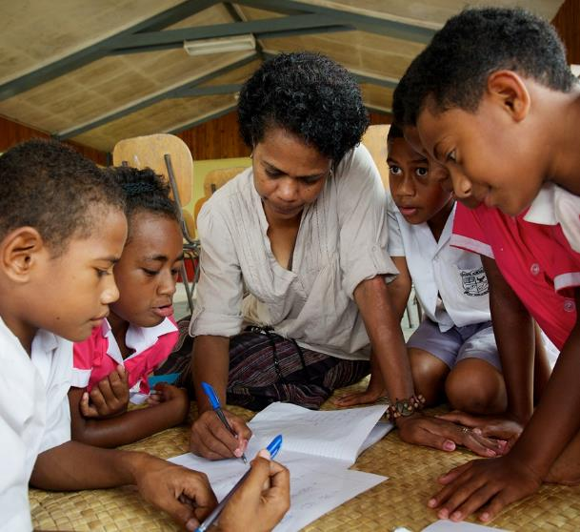
Article 28.
You have the right to a good quality education. You should be encouraged to go to school to the highest level you can.
Credit: Richard Wainright
Notes:
Article 28
1. States Parties recognize the right of the child to education, and with a view to achieving this right progressively and on the basis of equal opportunity, they shall, in particular:
(a) Make primary education compulsory and available free to all;
(b) Encourage the development of different forms of secondary education, including general and vocational education, make them available and accessible to every child, and take appropriate measures such as the introduction of free education and offering financial assistance in case of need;
(c) Make higher education accessible to all on the basis of capacity by every appropriate means;
(d) Make educational and vocational information and guidance available and accessible to all children;
(e) Take measures to encourage regular attendance at schools and the reduction of drop-out rates.
2. States Parties shall take all appropriate measures to ensure that school discipline is administered in a manner consistent with the child's human dignity and in conformity with the present Convention.
3. States Parties shall promote and encourage international cooperation in matters relating to education, in particular with a view to contributing to the elimination of ignorance and illiteracy throughout the world and facilitating access to scientific and technical knowledge and modern teaching methods. In this regard, particular account shall be taken of the needs of developing countries.

Slide 23

Article 29.
Your education should help you use and develop your talents and abilities. It should also help you learn to live peacefully, protect the environment and respect other people.
Credit: Caritas Australia
Notes:
Article 29
1. States Parties agree that the education of the child shall be directed to:
(a) The development of the child's personality, talents and mental and physical abilities to their fullest potential;
(b) The development of respect for human rights and fundamental freedoms, and for the principles enshrined in the Charter of the United Nations;
(c) The development of respect for the child's parents, his or her own cultural identity, language and values, for the national values of the country in which the child is living, the country from which he or she may originate, and for civilizations different from his or her own;
(d) The preparation of the child for responsible life in a free society, in the spirit of understanding, peace, tolerance, equality of sexes, and friendship among all peoples, ethnic, national and religious groups and persons of indigenous origin;
(e) The development of respect for the natural environment.
2. No part of the present article or article 28 shall be construed so as to interfere with the liberty of individuals and bodies to establish and direct educational institutions, subject always to the observance of the principle set forth in paragraph 1 of the present article and to the requirements that the education given in such institutions shall conform to such minimum standards as may be laid down by the State.

Slide 24
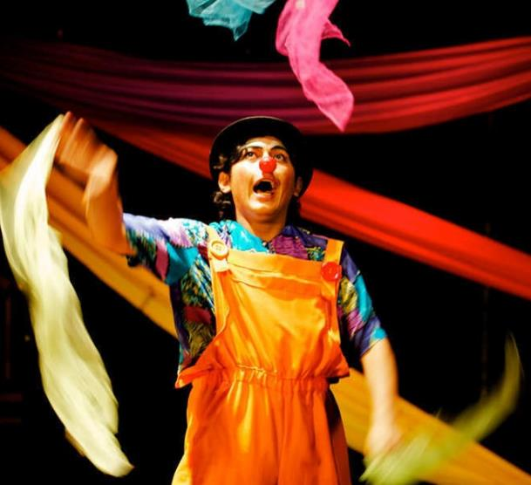
Article 31.
You have the right to play and rest.
Credit: Richard Wainwright
Notes:
Article 31
1. States Parties recognize the right of the child to rest and leisure, to engage in play and recreational activities appropriate to the age of the child and to participate freely in cultural life and the arts.
2. States Parties shall respect and promote the right of the child to participate fully in cultural and artistic life and shall encourage the provision of appropriate and equal opportunities for cultural, artistic, recreational and leisure activity.

Slide 25
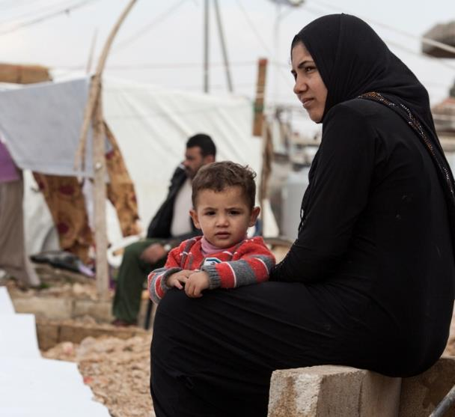
Article 38.
You have the right to protection and freedom from war. Children under 15 cannot be forced to go into the army or take part in war.
Credit: Caritas Switzerland
Notes:
Article 38
1. States Parties undertake to respect and to ensure respect for rules of international humanitarian law applicable to them in armed conflicts which are relevant to the child.
2. States Parties shall take all feasible measures to ensure that persons who have not attained the age of fifteen years do not take a direct part in hostilities.
3. States Parties shall refrain from recruiting any person who has not attained the age of fifteen years into their armed forces. In recruiting among those persons who have attained the age of fifteen years but who have not attained the age of eighteen years, States Parties shall endeavour to give priority to those who are oldest.
4. In accordance with their obligations under international humanitarian law to protect the civilian population in armed conflicts, States Parties shall take all feasible measures to ensure protection and care of children who are affected by an armed conflict.

Slide 26
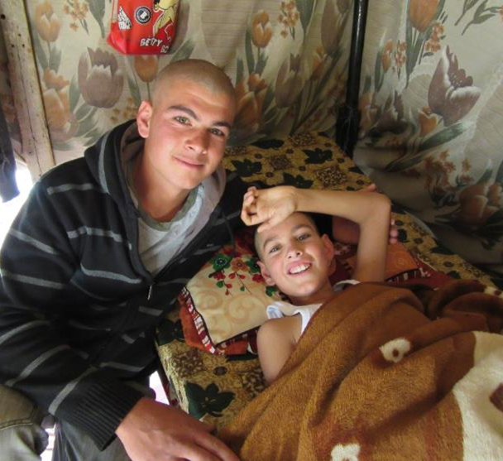
Article 39.
You have the right to help if you've been hurt, neglected or badly treated.
Credit: Andrew McConnell, CRS
Notes:
Article 39
States Parties shall take all appropriate measures to promote physical and psychological recovery and social reintegration of a child victim of: any form of neglect, exploitation, or abuse; torture or any other form of cruel, inhuman or degrading treatment or punishment; or armed conflicts. Such recovery and reintegration shall take place in an environment which fosters the health, self-respect and dignity of the child.

Slide 27
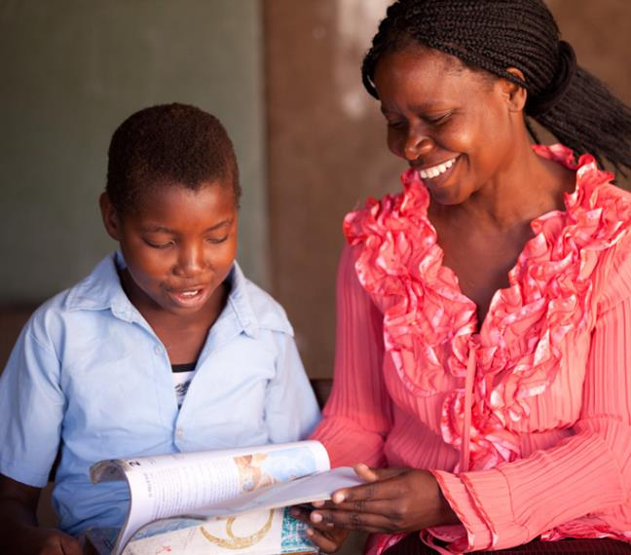
Article 42.
You have the right to know your rights! Adults should know about these rights and help you learn about them, too.
Credit: Erin Johnson
Notes:
Article 42
States Parties undertake to make the principles and provisions of the Convention widely known, by appropriate and active means, to adults and children alike.

Slide 28

TASK: 1. Choose 4 children’s rights you feel strongly about from this Presentation or any of the other UN ChilDren’s Rights (there are 54 in total) 2. Find an Image that relates to this United Nation Child right 3 Find a quote from Chapters 6 – 9 which is relevant to your chosen right/ image 4. Explain the UN Child right by embedding Your quotation from the Bone Sparrow 5. Use The rubric for embedding Quotations

